Slide 1
CS305
System Modeling and Simulation
Prof. Dr. Khaled Mahar
khmahar@aast.edu
Lecture 3

Slide 2
Chapter 5 Statistical Models in Simulation
Banks, Carson, Nelson & Nicol
Discrete-Event System Simulation

Slide 3
Purpose & Overview
The world the model-builder sees is probabilistic rather than deterministic.
Some statistical model might well describe the variations.
An appropriate model can be developed by sampling the phenomenon of interest:
Select a known distribution through educated guesses
Make estimate of the parameter(s)
Test for goodness of fit
In this chapter:
Review several important probability distributions
Present some typical application of these models
Notes:
Many real-life systems exhibit behavior with random elements:
Manufacturing
random demands for product held in an inventory system
random machine failures and repairs
Transportation
random congestion on a highway
random travel times between pairs of origination and destination
Telecommunications
random traffic arriving at a telecommunications network
random transmission time
Discrete-event simulations
random event occurrence times (e.g., random inter-arrival times at a manufacturing station)
random event transitions (e.g., random destinations of product units emerging from an inspection station

Slide 4
Review of Terminology and Concepts
In this section, we will review the following concepts:
Discrete random variables
Continuous random variables
Cumulative distribution function
Expectation

Slide 5
Discrete Random Variables [Probability Review]
X is a discrete random variable if the number of possible values of X is finite, or countably infinite.
Example: Consider jobs arriving at a job shop.
Let X be the number of jobs arriving each week at a job shop.
R_{x} = possible values of X (range space of X) = {0,1,2,…}
p(x_{i}) = probability the random variable is x_{i} = P(X = x_{i})
p(x_{i}), i = 1,2, … must satisfy:
The collection of pairs [x_{i}, p(x_{i})], i = 1,2,…, is called the probability distribution of X, and p(x_{i}) is called the probability mass function (pmf) of X.
Notes:
Countably Infinite. Describes a set which contains the same number of elements as the set of natural numbers. Formally, a countably infinite set can have its elements put into one-to-one correspondence with the set of natural numbers

Slide 6
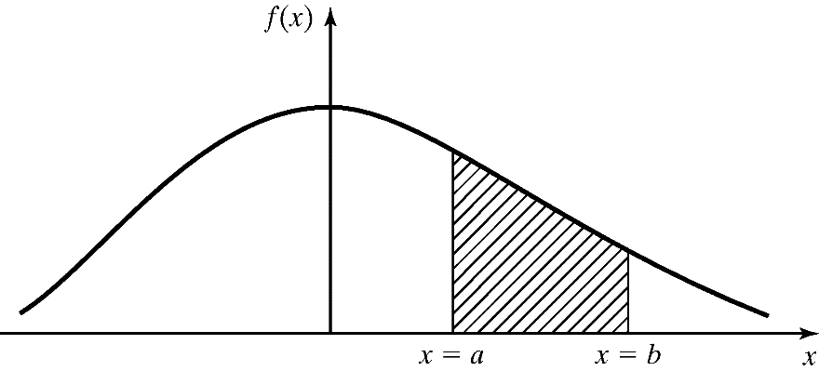
Continuous Random Variables [Probability Review]
X is a continuous random variable if its range space R_{x} is an interval or a collection of intervals.
The probability that X lies in the interval [a,b] is given by:
f(x), denoted as the pdf of X, satisfies:
Properties
Notes:
Pdf: probability density function

Slide 7
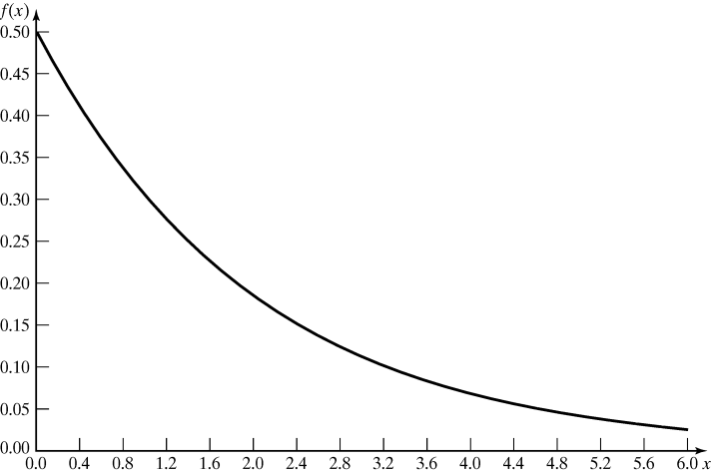
Continuous Random Variables [Probability Review]
Example: Life of an inspection device is given by X, a continuous random variable with pdf:
X has an exponential distribution with mean 2 years
Probability that the device’s life is between 2 and 3 years is:

Slide 8
Cumulative Distribution Function [Probability Review]
Cumulative Distribution Function (cdf) is denoted by F(x), where F(x) = P(X ≤ x)
If X is discrete, then
If X is continuous, then
Properties
All probability question about X can be answered in terms of the cdf, e.g.:

Slide 9
Cumulative Distribution Function [Probability Review]
Example: An inspection device has cdf:
The probability that the device lasts for less than 2 years:
The probability that it lasts between 2 and 3 years:

Slide 10
Expectation [Probability Review]
The expected value of X is denoted by E(X)
If X is discrete
If X is continuous
a.k.a the mean, m, or the 1st moment of X
A measure of the central tendency
The variance of X is denoted by V(X) or var(X) or σ²
Definition: V(X) = E[(X – E[X])²]
Also, V(X) = E(X²) – [E(x)]²
A measure of the spread or variation of the possible values of X around the mean
The standard deviation of X is denoted by σ
Definition: square root of V(X)
Expressed in the same units as the mean

Slide 11
Expectation [Probability Review]
Example: The mean of life of the previous inspection device is:
To compute variance of X, we first compute E(X²):
Hence, the variance and standard deviation of the device’s life are:

Slide 12
Useful Statistical Models
In this section, statistical models appropriate to some application areas are presented. The areas include:
Queueing systems
Inventory and supply-chain systems
Limited data

Slide 13
Queueing Systems [Useful Models]
In a queuing system, inter-arrival and service-time patterns can be probabilistic
Sample statistical models for inter-arrival or service time distribution:
Exponential distribution: if service times are completely random
Normal distribution: fairly constant but with some random variability (either positive or negative)
Truncated normal distribution: similar to normal distribution but with restricted value.
Gamma and Weibull distribution: more general than exponential (involving location of the modes of pdf’s and the shapes of tails.)
Notes:
Normal Distribution example: The time it take for a lathe to traverse a 10-cm shaft always be the same. However, the material could have a slight differences in the hardness.
The tail of Gamma is long.
If large service times (much larger than the mean) occur more frequently than the exponential distribution can account for, the Weibull distribution can be used
Weibull: Got right-skewed data? Weibull can model that. Left-skewed data? Sure. Symmetric data? Weibull's up for it. It is flexible.
An assumption of the exponential distribution is that the probability of an event/failure is constant over time. In many real-world situations this is inaccurate. Often the probability of a part's failing, for example, increases in proportionately to the time in use or operation. The Weibull distribution accounts for this.
The Weibull distribution contains parameters that reflect the change in rate of occurrence as a function of time. When the rate is held constant, the Weibull and exponential distributions are identical

Slide 14
Inventory and supply chain [Useful Models]
In realistic inventory and supply-chain systems, there are at least three random variables:
The number of units demanded per order or per time period
The time between demands
The lead time
Sample statistical models for lead time distribution:
Gamma
Sample statistical models for demand distribution:
Negative binomial distribution: longer tail than Poisson (more large demands).
Poisson: for fewer large demands
Geometric: at least one demand has occurred.
Notes:
Lead time: time between placing the order and receiving that order.
If the demand is long-tailed, the negative binomial is more appropriate (Poisson has a shorter tail)

Slide 15
Limited Data
If the data obtained is limited or incomplete, there are usually three distributions that are used:
Uniform Distribution
Inter-arrival or service times are known to be random
No other information is known about the distribution
Triangular Distribution
When assumptions can be made about the maximum, minimum and modal values of the distribution
Beta Distribution
Provides a variety of distribution forms on the unit interval
These distributions can be shifted to any other interval

Slide 16
Other areas [Useful Models]
Other distribution: Bernoulli, binomial and hyper-exponential.

Slide 17
Discrete Distributions
Discrete random variables are used to describe random phenomena in which only integer values can occur.
In this section, we will learn about:
Bernoulli trials and Bernoulli distribution
Binomial distribution
Geometric and negative binomial distribution
Poisson distribution

Slide 18

Bernoulli Trials [Discrete Dist’n]
Context: Random events with two possible values
Two events: Yes/No, True/False, Success/Failure
Two possible values: 1 for success, 0 for failure.
Example: Tossing a coin, Packet Transmission Status,
A Bernoulli random variable may be used to model whether a job departing from a machine is defective (failure) or not (success).

Slide 19
Bernoulli Trials (cont.) [Discrete Dist’n]
Bernoulli Trials:
Consider an experiment consisting of n trials, each can be a success or a failure.
Let X_{j} = 1 if the jth experiment is a success
and X_{j} = 0 if the jth experiment is a failure
The Bernoulli distribution (one trial):
where E(X_{j}) = p and V(X_{j}) = p (1-p) = p q
Bernoulli process:
The n Bernoulli trials where trails are independent:
p(x₁,x₂,…, x_{n}) = p₁(x₁) p₂(x₂) … p_{n}(x_{n})

Slide 20
Binomial Distribution [Discrete Dist’n]
Context: Number of successes in a series of n trials.
Example: the number of 'heads' occurring when a coin is tossed 50 times.
The number of successful transmissions of 100 packets.
A binomial random variable may be used to model the total number of defective items in a given batch.
A binomial trial can be a much faster procedure than conducting multiple Bernoulli trials.

Slide 21
Binomial Distribution [Discrete Dist’n]
The number of successes in n Bernoulli trials, X, has a binomial distribution.
The mean, E(x) = p + p + … + p = n*p
The variance, V(X) = pq + pq + … + pq = n*pq
The number of outcomes having the required number of successes and failures
Probability that there are
x successes and (n-x) failures

Slide 22
Binomial Distribution [Discrete Dist’n]
Probability of x=2 successes in n=3 trials?
E1: 1 1 0
P(E1)= p(1 and 1 and 0) = p p (1-p) = p2 (1-p)
or
E2: 1 0 1
P(E2)= p(1 and 0 and 1) = p (1-p) p = p2 (1-p)
or
E3: 0 1 1
P(E3)= p(1 and 1 and 0) = p p (1-p) = p2 (1-p)
Probability of x=2 successes in n=3 trials?

Slide 23
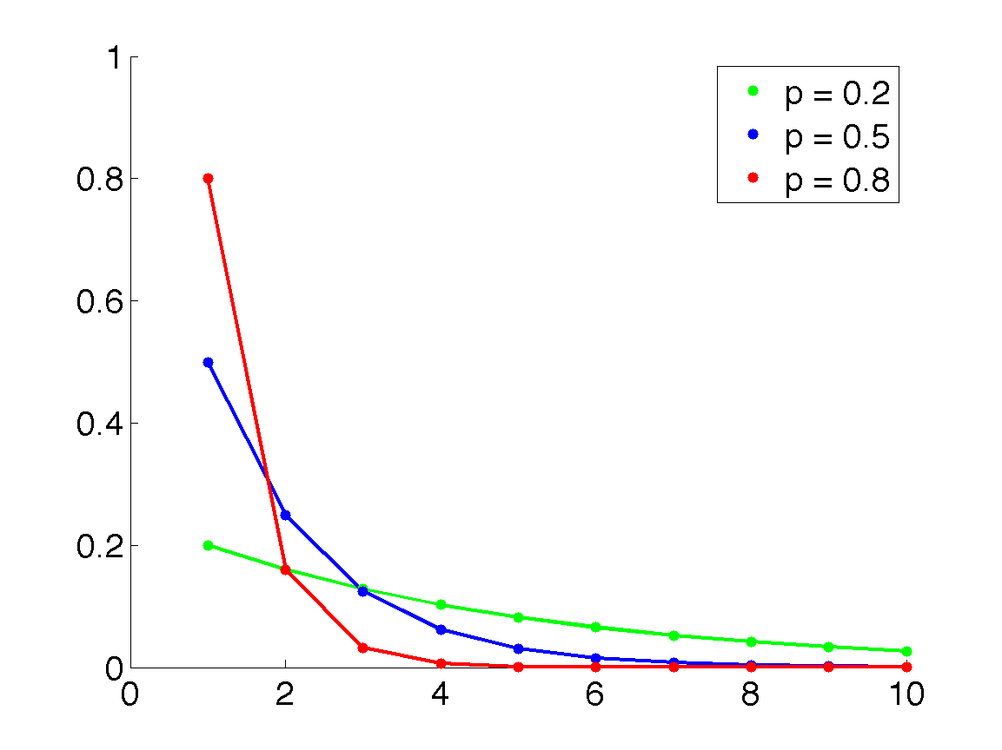

Geometric Distribution [Discrete Dist’n]
Geometric distribution
The number of Bernoulli trials, X, to achieve the 1st success.
A geometric random variable may be used to model the number of good product units, separating consecutive bad (defective) ones
E(x) = 1/p, and V(X) = q/p²
$$CDF:F\left(X\right)=p\left(X≤x\right)=1−{(1−p)}^{x}$$
PMF
x

Slide 24

Geometric Distribution [Discrete Dist’n]
Example: A representative from Football League's Marketing Division randomly selects people on a random street in a city until he finds a person who attended the last football game. Let p=0.20, be the probability that he succeeds in finding such a person. And, let X denote the number of people he selects until he finds his first success.
What is the probability that the marketing representative selects 3 people before he finds one who attended the last football game?
P(X=4)=0.8³*0.2¹=0.1024
What is the probability that the marketing representative must select more than 6 people before he finds one who attended the last home football game?
P(X>6)=1-P(X ≤6)=1-[1-(1-0.2)⁶]=0.262 by using
$$CDF:F\left(X\right)=p\left(X≤x\right)=1−{(1−p)}^{x}$$

Slide 25
Negative Binomial Distribution [Discrete Dist’n]
Negative binomial distribution
Let X denote the number of Bernoulli trials, until the k^{th} success. Then, the probability mass function of X is:
Notes:
It is called also, Pascal distribution

Slide 26
Negative Binomial Distribution [Discrete Dist’n]
Example: An oil company conducts a geological study that indicates that an exploratory oil well should have a 20% chance of striking oil. What is the probability that the third strike comes on the seventh well drilled?
Solution. To find the requested probability, we need to find P(X = 7), which can be readily found using the p.m.f. of a negative binomial random variable with p = 0.20, 1−p = 0.80, x = 7 and k = 3:

Slide 27
Poisson Distribution [Discrete Dist’n]
Context: number of events occurring in a fixed period of time
Events occur with a known average rate and are independent
Possion distribution is characterized by the average rate λ
The average number of arrival in the fixed time period.
Examples
The number of cars passing a fixed point in a 5 minute interval. Average rate: λ = 3 cars/5 minutes
The number of calls received by a switchboard during a given period of time. Average rate: λ =3 call/minutes
The number of message coming to a router per second
The number of travelers arriving to the airport for flight registration
Notes:
27

Slide 28
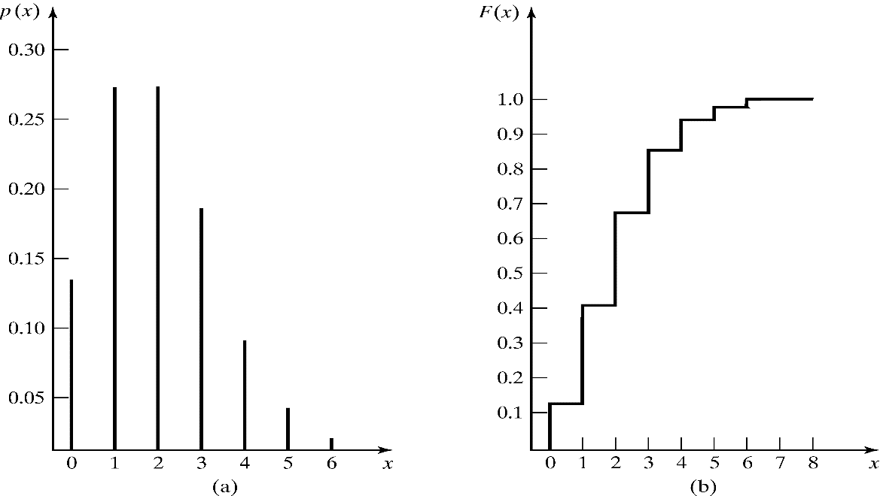
Poisson Distribution [Discrete Dist’n]
Poisson distribution describes many random processes quite well and is mathematically quite simple.
where λ > 0, pdf and cdf are:
E(X) = λ = V(X)

Slide 29
Poisson Distribution [Discrete Dist’n]
Example: A computer repair person is “beeped” each time there is a call for service. The number of beeps per hour ~ Poisson(λ = 2 per hour).
The probability of three beeps in the next hour:
p(3) = e⁻²2³/3! = 0.18
also, p(3) = F(3) – F(2) = 0.857-0.677=0.18
The probability of two or more beeps in a 1-hour period:
p(2 or more) = 1 – p(0) – p(1)
= 1 – F(1)
= 0.594

